Slide 1

I-Focus
Group 10-11 Samuel Leong 4S1(17)
Ryan Tan 4S1(21)
Walter Kong 4O3(33)
Xiao Songyuan 4S2(20)

Slide 2
Introduction

Slide 3
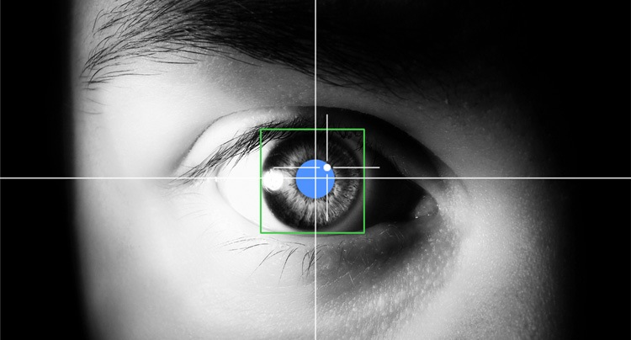
EFFICIENT.
Effective.
INTUITIVE.
Eye-tracking: Look at where you want the cursor to move.
Multi-modal Input: Eye-tracking + Clicks + Head gestures

Slide 4


Objectives
DSO

Slide 5

Target Audience
Physically Disabled
General Public

Slide 6

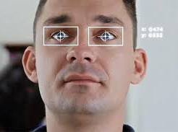
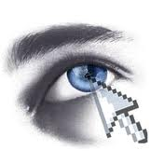

Why I-Focus?
Notes:
[shorten if possible]
So this leads us to answer the question – why I-Focus? Why do we need a revamp in the current forms of mouse and even touchscreen inputs for able-bodied people?
…
3 words: efficiency, effectiveness and intuitiveness
The one-size-fits-all model of kinesthetic input which we get from the mouse is simply inefficient and unintuitive. We use the mouse for everything – clicking, moving, dragging.. And the only reason why we find the mouse pretty effective and efficient is because we have been using it for a long time. [projector screen example] With eye-tracking, everything is fast, efficient and convenient. Just look at where you want to move and click. Look at a link, click on it. Look at an icon, open the application. Efficient. Effective. Intuitive.

Slide 7
Application

Slide 8

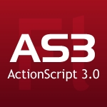

Programming Languages
HTML 5
CSS 3
JavaScript
#
Notes:
Breeze thru

Slide 9
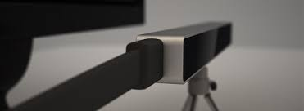
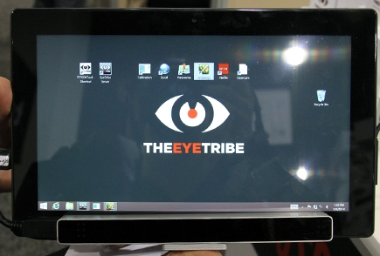
Devices
EyeTribe Eye-Tracker
Affordable
Accurate
Notes:
The device we would be using is the EyeTribe eye-tracker, which is affordable compared to other professional ones (that costs above 5000) and a lot more accurate than webcams.

Slide 10
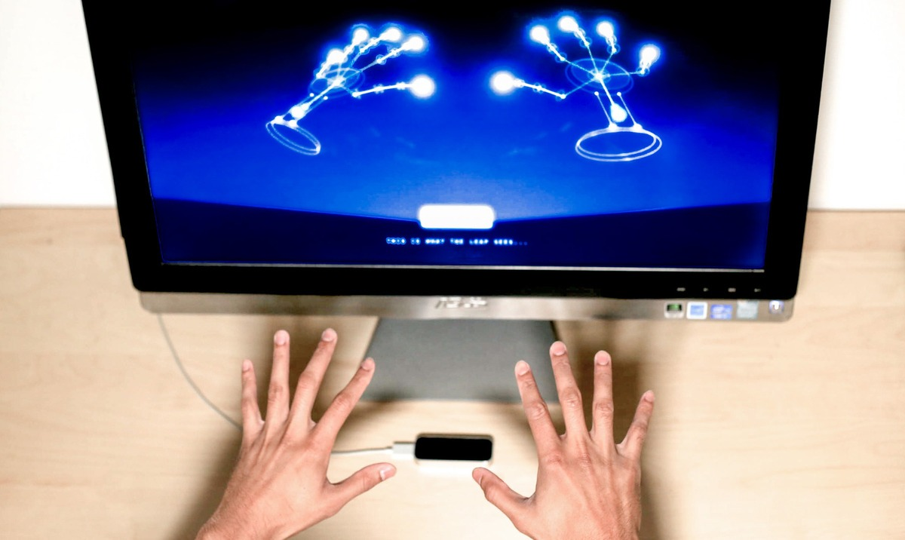
Devices
Leap Motion
Physical Input
Hand Gestures

Slide 11
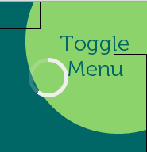
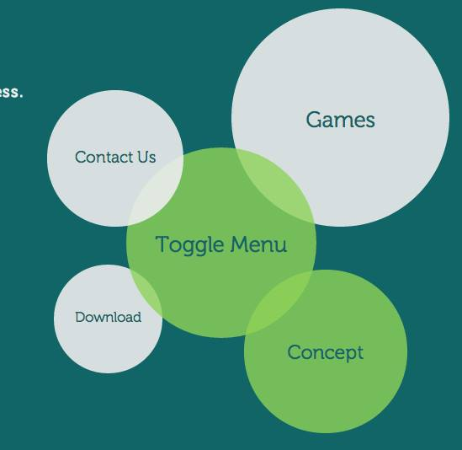
Features
Auto-scrolling
Modified Cursor
Video Control
Radial Menu

Slide 12
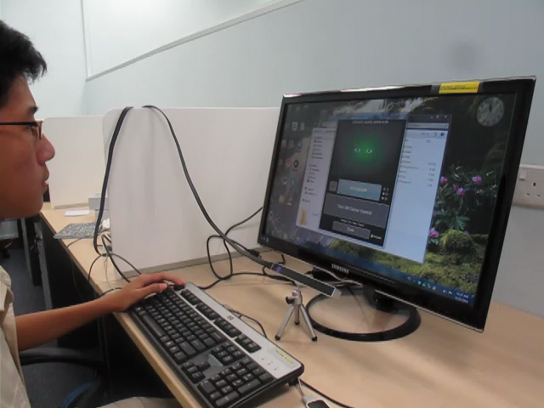
Screenshots

Slide 13
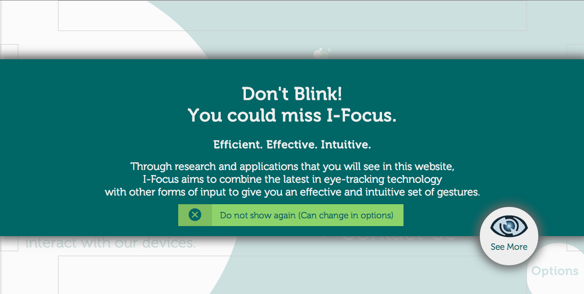
Screenshots

Slide 14
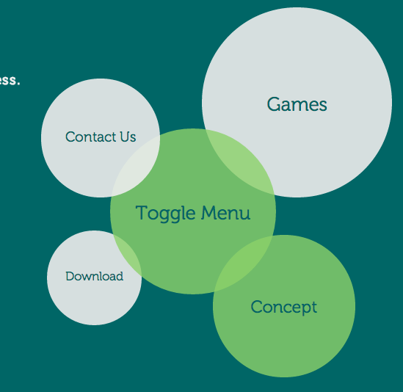
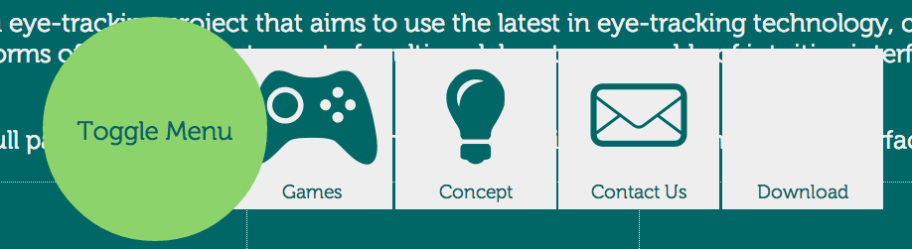
Screenshots
Notes:
Briefly talk about reason for having tabbed vs radial menu
Size difference
Speed
Left-to-right reading

Slide 15
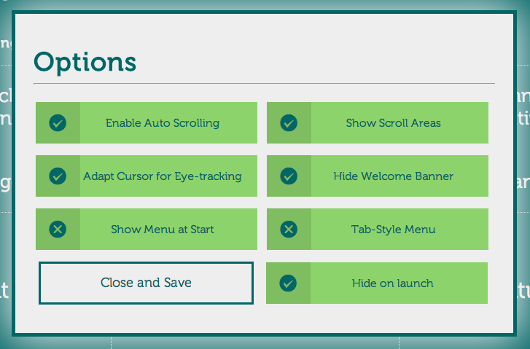
Screenshots

Slide 16

Screenshots

Slide 17

The Full Package
Research
Gestures
Console App
Website
Games
Notes:
Gestures => Console App (bridge) => Website & Games => Backed up by Research.

Slide 18

Live Demo
Efficient.
Effective.
Intuitive.
Notes:
Game (comparison)
Eye-tracking
Mouse
Website (features – for a purely hands-free interface for disabled)
Menu
Modified cursor
Auto-scroll
Video function
Other features
Dasher?
Typing program for disabled

Slide 19
Research

Slide 20
Video
Notes:
[Video]

Slide 21
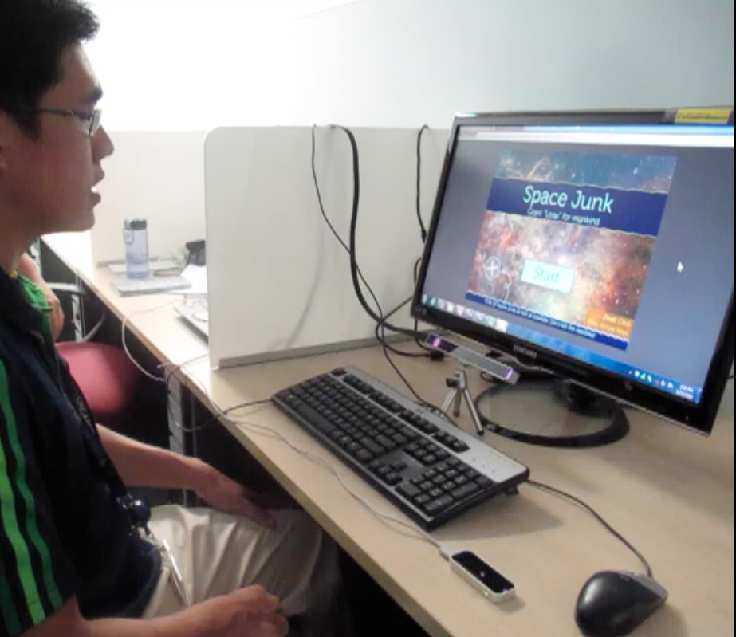
Research Setup
Participant
Big Screen
Eye-Tracker
Fixated Mouse
Leap Motion
Notes:
[Setup]

Slide 22
Research Procedure
6 Live Participants
Game
Website
Quantitative (Timing) + Qualitative (Survey) Data
Test suitability of input methods for tracking tasks
Eye-Tracker
Mouse
Leap Motion
Notes:
[Experimental Procedure]

Slide 23
Research Procedure
6 Live Participants
Game
Website
Questionnaire for User Interaction Satisfaction (QUIS)
Compare 2 versions of website
Menu
Arrangement
Selection Method
Scrolling Method
Notes:
[Experimental Procedure]

Slide 24
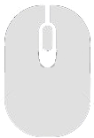
Results - Game
* Lower the timing, the better.
Notes:
[Results; bar graphs, charts, tables]
[General comments and KEYWORDS (positive ones)]

Slide 25
Comments - Game
Eye-Tracking
“if accurate, it is… as good (1) or better (4) than a mouse”
“It’s is pretty intuitive”
Like that they “literally get what they see”
“Quite jittery, but very fast”
Should try sound input as a selection method… It’s more intuitve
Notes:
[Results; bar graphs, charts, tables]
[General comments and KEYWORDS (positive ones)]

Slide 26
Comments - Game
Pure Leap Motion
Not good
“Too tiring”
“Prone to errors”
Gestures unresponsive
Accidental clicks
Notes:
[Results; bar graphs, charts, tables]
[General comments and KEYWORDS (positive ones)]

Slide 27
Results - Website
* QUIS survey used. Higher the scores, the better.
Notes:
[Results; bar graphs, charts, tables]
[General comments and KEYWORDS (positive ones)]

Slide 28
Results - Website
Overall Preference
Notes:
[Results; bar graphs, charts, tables]
[General comments and KEYWORDS (positive ones)]

Slide 29
Results - Website
Content
Most preferred radial menu as it was larger
5/6 participants preferred kinesthetic clicks
Modified cursor was considered too ineffective and too frustrating.
But, modified cursor scores were consistently above 5.
* QUIS survey used. Higher the scores, the better.
Notes:
[Results; bar graphs, charts, tables]
[General comments and KEYWORDS (positive ones)]

Slide 30
Findings - Website
Video function should…
Be made an option
Have buffer time before auto-pausing
Reduce play timer
Cursor moving while reading is irritating
Cursor should disappear while over text
Radial Menu is better
Larger Area
Faster
Notes:
[Results; bar graphs, charts, tables]
[General comments and KEYWORDS (positive ones)]

Slide 31
Findings - Others
Calibration works better with lights on
Small eyes/Bad angle
More jitter and poorer accuracy
Larger Screen
Better Accuracy
Notes:
[Results; bar graphs, charts, tables]
[General comments and KEYWORDS (positive ones)]

Slide 32
Summary
Once eye-tracker is accurate enough,
Eye-tracking beats the mouse in terms of...
Speed/Efficiency
Targeting & Tracking tasks
Intuitiveness
Efficient.
Effective.
Intuitive.

Slide 33
Methodology

Slide 34
Methodology

Slide 35

Timeline
Prelim Presentation
Semis Presentation
Finals Presentation
Prelim
Semis
Finals
Planning
Developmental
Implementation
Alpha Testing
Beta Testing
Extensions

Slide 36
Looking to the Future...
Improving the Input Methods
Sound input over physical input
Improving Accuracy
Head tracking to mitigate precision
Improve Interface
Further Research
Suitability of certain tasks for eye-tracking

Slide 37
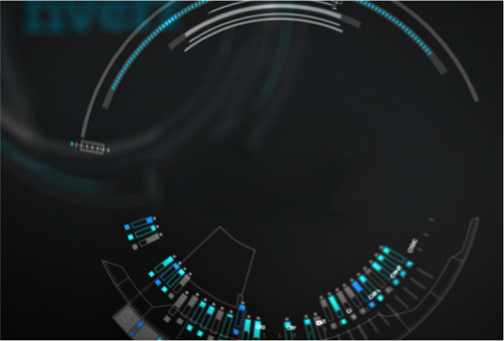
Thank You!
Notes:
“More than meets the eye”
“… in the blink of an eye”
“Look!”
“Don’t blink!”

